Slide 1

92.7 big FM SQL Analysis
Presented By: SAHNAWAJ Ahmed

Slide 2

Challenge:
To craft SQL queries to extract insights from 92.7 Big FM Radio network Database
Tables:
Awards
Hosts
OnlinePresence
Partnerships
Showpartnerships
Shows
Stations

Slide 3
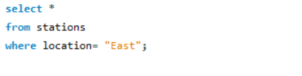
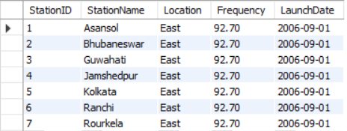
Q1. Retrieve all stations in the "East" region?

Slide 4
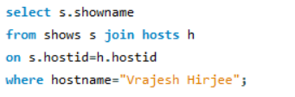

Q2. List all shows hosted by "Vrajesh Hirjee"?

Slide 5
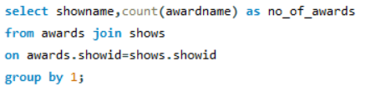
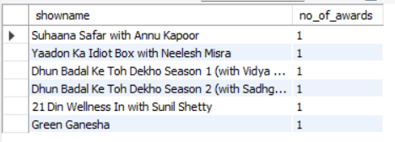
Q3. Count the number of awards each show has won?

Slide 6
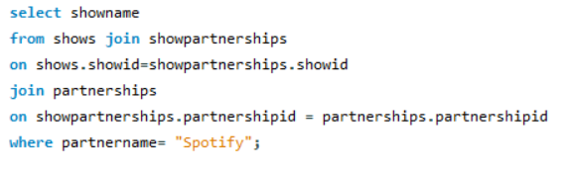

Q4. Find shows that have partnerships with "Spotify"?

Slide 7

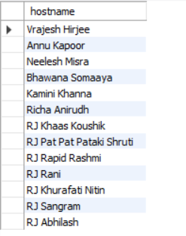
Q5. Retrieve hosts who joined before 2010?

Slide 8

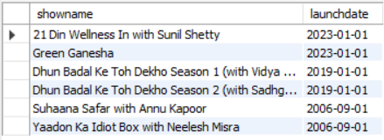
Q6. List the shows and their launch dates in descending order of launch date?

Slide 9

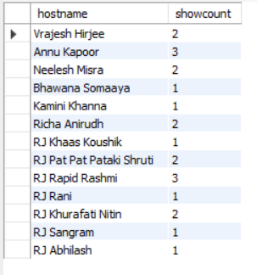
Q7. Find the total count of shows for each host?

Slide 10

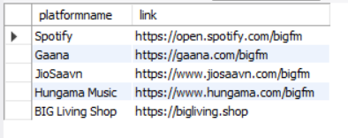
Q8. Show the online presence platforms with their links?

Slide 11


Q9. Retrieve the stations in the "South" region launched after 2010?
*There is no such records.

Slide 12

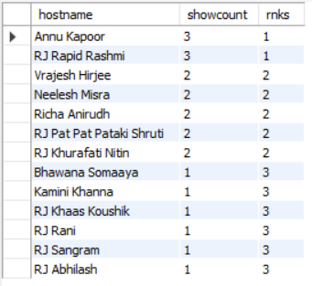
Q10. Rank hosts based on the number of shows they have hosted?

Slide 13
Thank you

